Slide 1

Azure Data Factory
Fascinating ETL TOOL

Slide 2
Context:
History of ADF :slide No : 3 to 13
Getting Started with ADF : slide No : 14 to 20
ADF Studio : slide No : 21 to 25
Pipeline Activities : slide NO : 26 to 63
Triggers : slide NO : 64 to 70
Data Flows : slide NO : 71 to 108

Slide 3
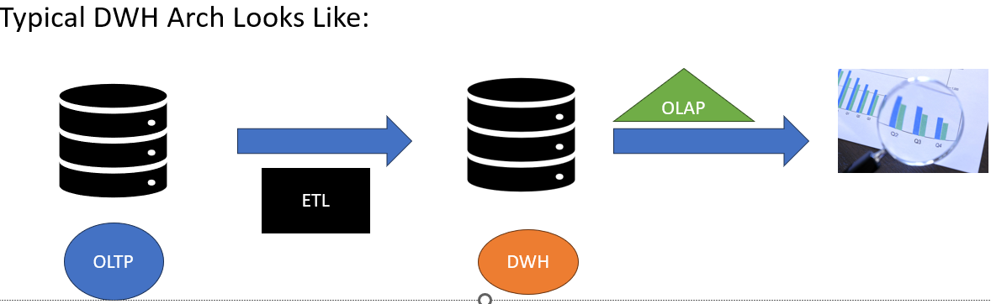
History of ADF:
To Describe the History of ADF , let’s first Discuss about the History of Datawarehouse (DWH)
In 1980’s when Businesses wants to Make the decisions on all the Data available in the Organization in one place rather than looking at data in Individual Department or sources
DWH is nothing but a giant Database with high Storage capacity and used to Store roughly 30-40 years of data with ease .
On top of the Datawarehouse , analyst performs analysis that is called OLAP

Slide 4
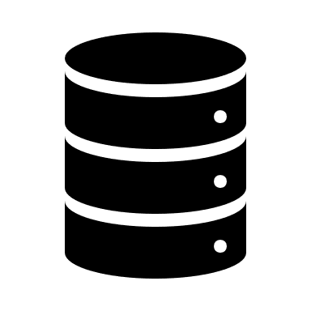
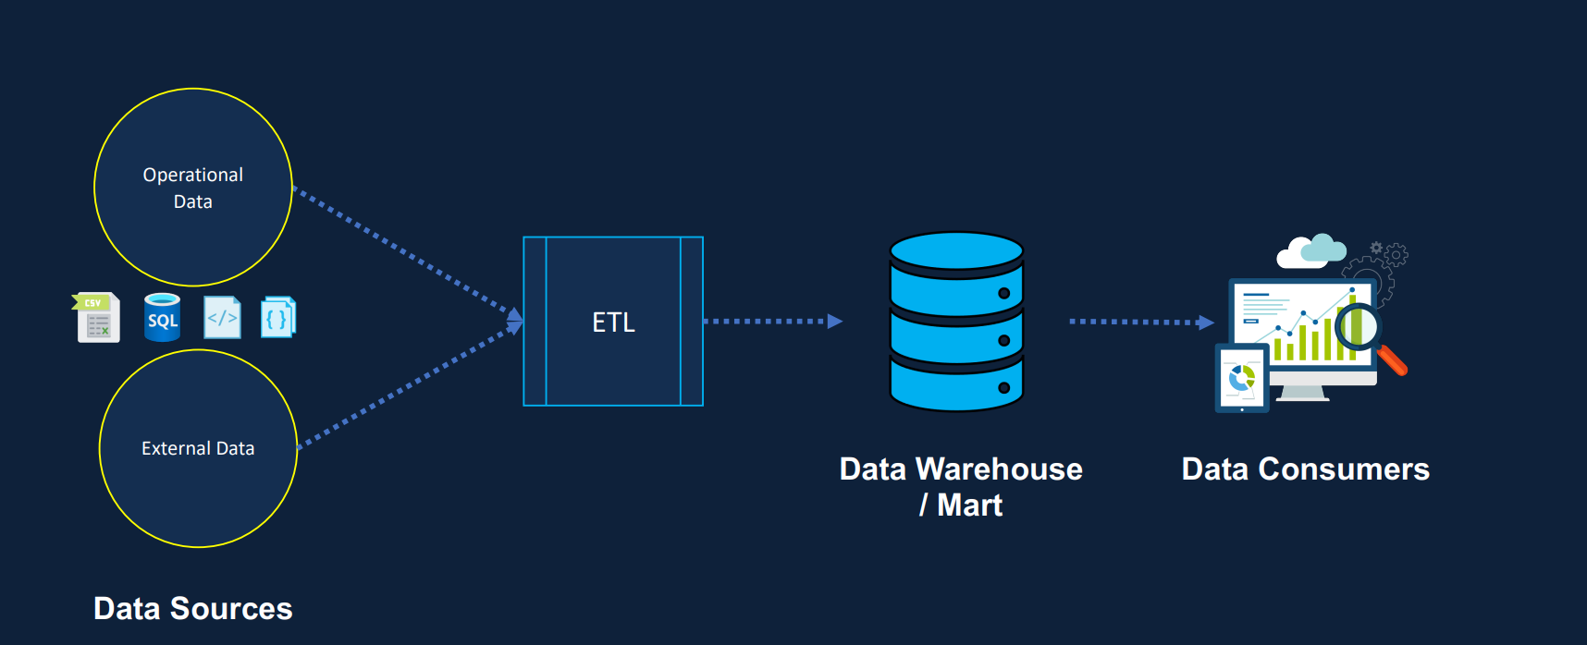
Old Datawarehouse :

Slide 5
Continue..
As you can see the above slide image, we have different sources are like files, tables from database and external sources like from IOT devices and data from any application etc., Those are considered as OLTP according our Typical DWH Arch
So, what ever we are getting the data from different sources that must dump or loaded into the DWH where we have Dimensions and Fact Tables .
To dump the data into DWH we use the ETL Tools like : IICS, PowerCenter, Talend, SSIS, ADF, Glue, Power Query etc.,
ETL means : Extract, Transform and Load . Let’s discuss about ETL Shortly in the next slide

Slide 6
::ETL::
ETL : Is an automated Data pipeline Engg Methodology.
E : Extract : Extracting the data from different sources
T : Transform : Transforming Data into the format for the suitable output like : Data cleaning and processing
L : Load : Loading the Transformed Data into a Destination that may be DWH or to any Distributed File System like Azure Storage layer, AWS S3, HDFS etc.,
Use Cases of ETL:
Digitizing the analog Media
Moving data from OLTP TO DWH
Training and Deploying the ML model etc.,
Tools: Common ETL Tools are ADF, Talend, IICS, SSIS etc.,

Slide 7
Data Sources for Extraction
Example of Raw Data Sources:
Paper Documents, webpages, Analog audio/video, Survey and Statistics Data
Transactional Data, DataBase
Example of Event Based Data:
Social Media Streams, weather Station networks, flight data , IOT data

Slide 8
:::Data Transformation:::
Data Transformation Involve various operations, such as :
Data TypeCasting
Data Structuring (json to csv, csv to DB Table)
Data encrypting
Data Cleaning like Removing Duplicates, Identity Missing columns etc.,
For Data Normalizing, Filtering, aggregating, joining etc.,
To do Transformations we can use:
Sql, Pyspark, Scala, M query also using no-code operations like DataFlows in ADF, Power Query Buttons in Power Bi

Slide 9

:::Data Loading Process :::
Once after data transformation has been done then the next step is used to load into the destination area that may be DWH or some where else by using following Loading Techniques
Full Load
Incremental Load
On-Demand load or Scheduled Load
Batch and Stream loading methods
Parallel method (Data splited into small chunks and load simultaneously )
To load the data, we may use some of the Tools like Airflow, Triggers in ADF etc.,

Slide 10
Issues with Old DWH:
Later in 2000’s , so much of Unstructured Data came into picture . Our DWH doesn’t support for Unstructured Data
In old DWH it takes longer time to ingest the new data
On-prim DWH is difficult to scaleup and expensive to store the data
Lack of support for ML/AI workloads
In old DWH Compute and Storage are tightly coupled
To overcome these issues Modern DWH or Cloud DWH comes into the market.

Slide 11
:::Modern DWH:::
Modern DWH or Cloud Based DWH solves the issues of old DWH like :
No need to worry about hardware maintenance, scalability
It can scale compute or storage up or down in a minutes
In cloud DWH Storage and Compute are separate . So, they are going to Billed Separately and only when they are in use
Also, It can integrate with other services
Speed up the processing time
Using Data Lake concept to handle the Unstructured data

Slide 12
Typical Modern or Cloud DWH::
Compute Layer
Data Sources
Ingest
Explore
Transform
DWH model
BI
Storage Layer

Slide 13
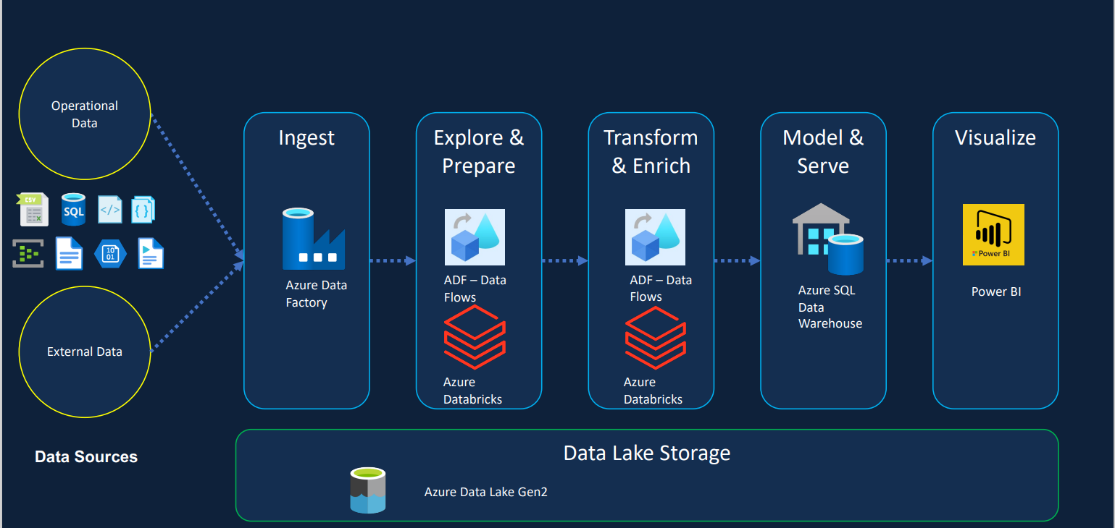
::Azure Cloud DWH or Modern DWH::

Slide 14

::Getting Started With ADF::
Azure Data Factory or ADF it’s one of the best ETL Tool in the market produced by Microsoft .
The Major Sections or components of ADF are:
Author Section, Monitor Section, Manage Section
Author
Monitor
Manage

Slide 15
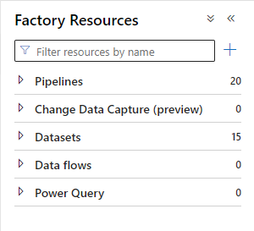
Author Components:
This Section is used to Design a Pipelines, Defining Data Sets, Dataflow’s mostly
Pipelines: It’s the logical-group of different activities to achieve a task like extract from different sources ,transforming and loading
Data Sets: It represents data structures within data stores or individual object of Datastore like Tables in DB, API’s , Files
Data flows: This a No-Code component used to do data transformations or modification inside the adf

Slide 16
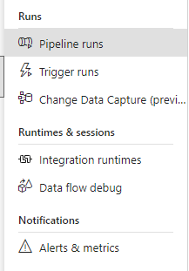
::Monitor Component::
This section is used to monitor our pipeline runs, Trigger Runs, Data flows Debug, Alerts and Metrics. and about Integration Runtime involved in our Data Factory Environment

Slide 17
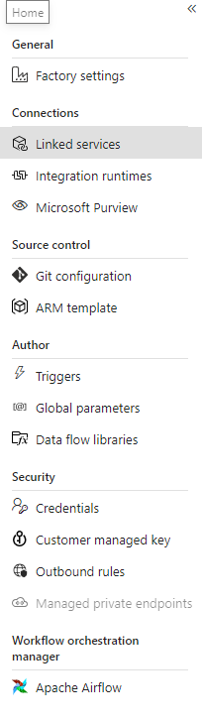
::Manage Section::
This section is used to create Linked Services, Integration runtimes, git configuration , arm template and information about security concerns and global parameters
Also, about the Orchestrating Pipelines or flows using Airflow

Slide 18
Overall Top-level Components:
Out of all the sections like monitor, author, manage here are following important components that we are regularly used most of the times are:
Pipelines: It’s the logical-group of different activities to achieve a task like extract from different sources ,transforming and loading
Activity : Represents the processing step in a pipeline like CopyData, LookUp etc.,
Linked Service: It’s the connection object or string used to connect external data source like Filesystem, Database etc.;
Data Sets: It represents data structures within data stores or individual object of Datastore like Tables in DB, API’s , Files . These utilizes Linked Service . For example : Linked Service is for the Database and Dataset is for the individual object in that Database like tables
Integration Runtime : It’s for creating computation Infrastructure, means when we run the pipeline at Background this IR provide VCup's, VMemory etc. By default, ADF uses Auto Resolving Integration Runtime.

Slide 19
:Important Points:
Before, getting started with ADF Basics let’s look over some of important point to be notice
Resource Group {RG}: It’s a container that holds related resources information for an Azure solution . It can include all the resources for the solution or only those resource that you want to manage as group. Example When you want to create Storge account or ADF it’s necessary to define an RG .so, that all our storage account’s , ADF related information can be found under one RG
Storage Accounts: Storge Account is used in Azure to store our files or any kind of stuff they're that may be Unstructured/Semi/Structured Data . Basically, Azure consists of Two major Storage Account’s a)Blob Storage b)Gen2.Storage Accounts name must be unique through out all existing storage acc names in Azure environment
Containers : Containers are nothing but a Sub-Folders inside the main Folder (Storage Account).Practically inside the containers we will store our data that may be in Blob Storage or Gen2
Blob Storage: It’s one of the storage object in Storage Accounts, used for storing massive amount of unstructured data. Inside Blob Storage we can create containers , But with No Hieratical Structure means you can’t create sub-sub- folder like structure inside the containers. Blob storage is designed for serving images or documents directly to a browser, writing/storing logfiles into it.
Gen2 Storage: It’s also one of the Storage object where generally used to store all kind of data and, we can maintain Hieratical Structure inside the containers . Most of time we use this as a Data Lake

Slide 20
Continue…
Parameters : These are two types one is Dataset parameters, and another one is Pipeline parameters .Parameters can’t be modified
Variables : Variables are values that can be set and modified during a pipeline run.
More info : https://learn.microsoft.com/en-us/azure/data-factory/concepts-parameters-variables

Slide 21
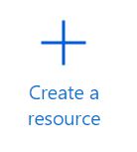
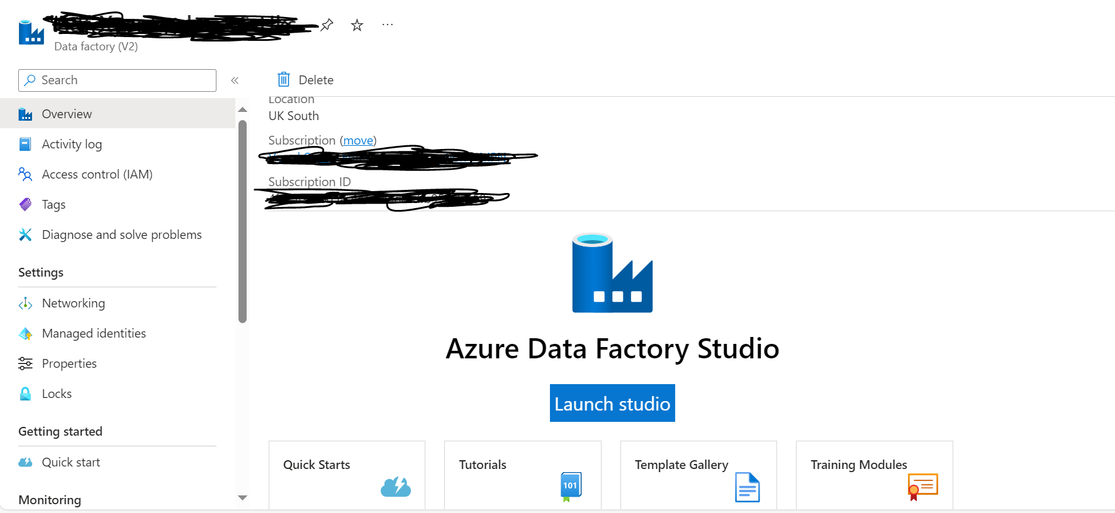
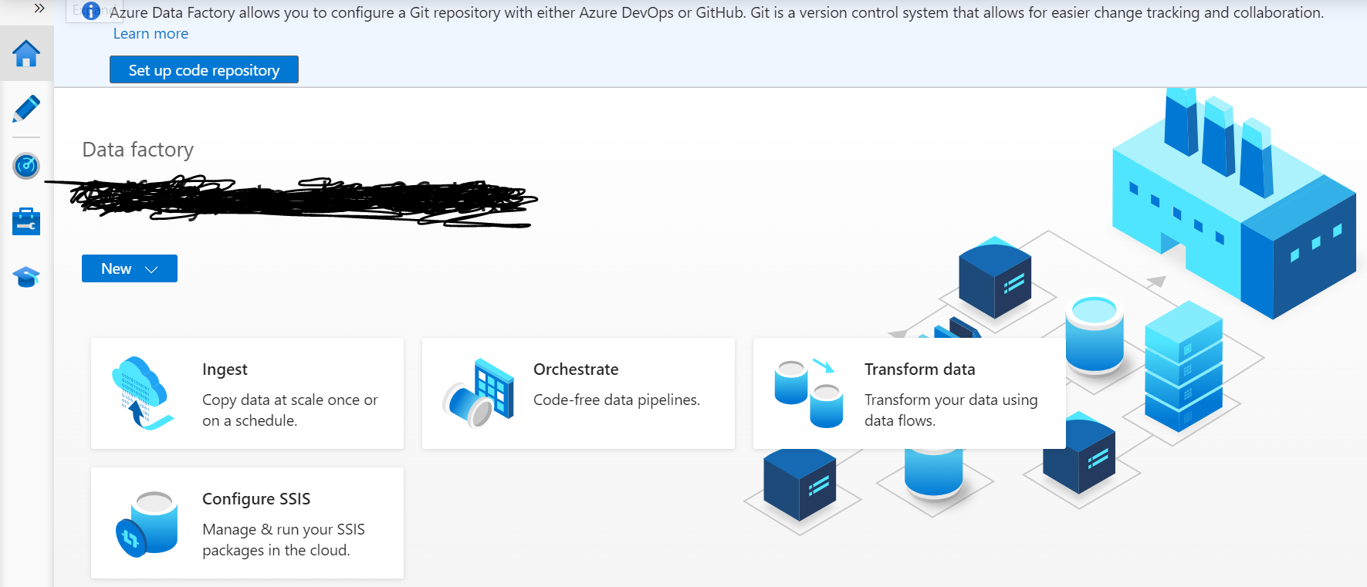
::ADF Basics::
Create the Azure Data Factory as the first step as follows
1) Click on Create resource in portal
2)Search Azure Data Factory and click on it
3)Define the name and Resource Group , Region and some other necessary requirements . Once after Successfully created you will land into ADF environment and hit the Launch Studio Button
Launch

Slide 22
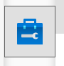
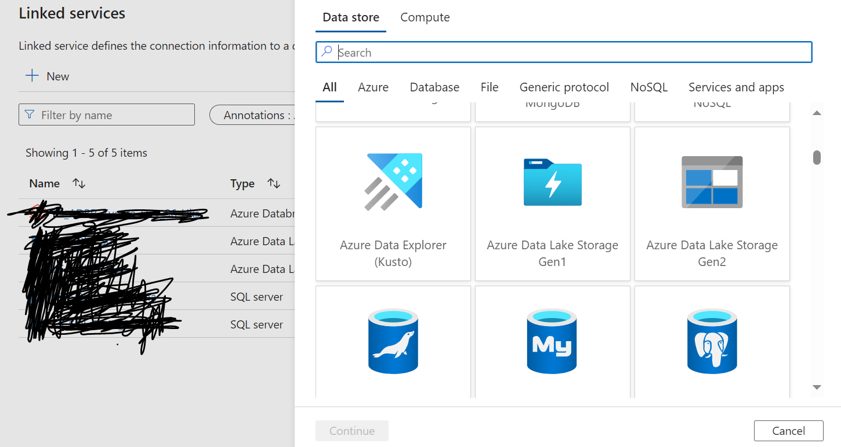
::Dive into Manage Section::
One of the Most important Section in ADF environment is Manage Section. Under manage section let’s first create the Linked Services for establishing the connection for the source like Gen2, SQL Server etc.,
If you want to connect other than Data source which is present in on-prim like local files or local SQL database, then need to define self-hosted Integration service instead of Azure Auto Integration service
Under the Manage Section we have Integration Runtime component.. There we can create Self-hosted
Define the related information and then test that connection just to make sure our linked service working properly
after

Slide 23
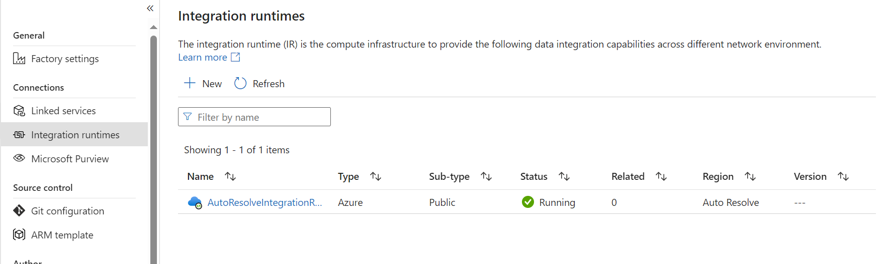
Continue…
Integration Runtime:
Under Source Control we can configure of Pipelines to Git repo that may be a Git or Azure Devops
ARM Template is nothing but a Json code which is developed from our designed or developed pipeline’s . This Template is going to be used at time of Building Test and prod pipelines from the dev pipelines .
Under Author section we can define the Triggers and Parameters for our pipelines for the Orchestration

Slide 24

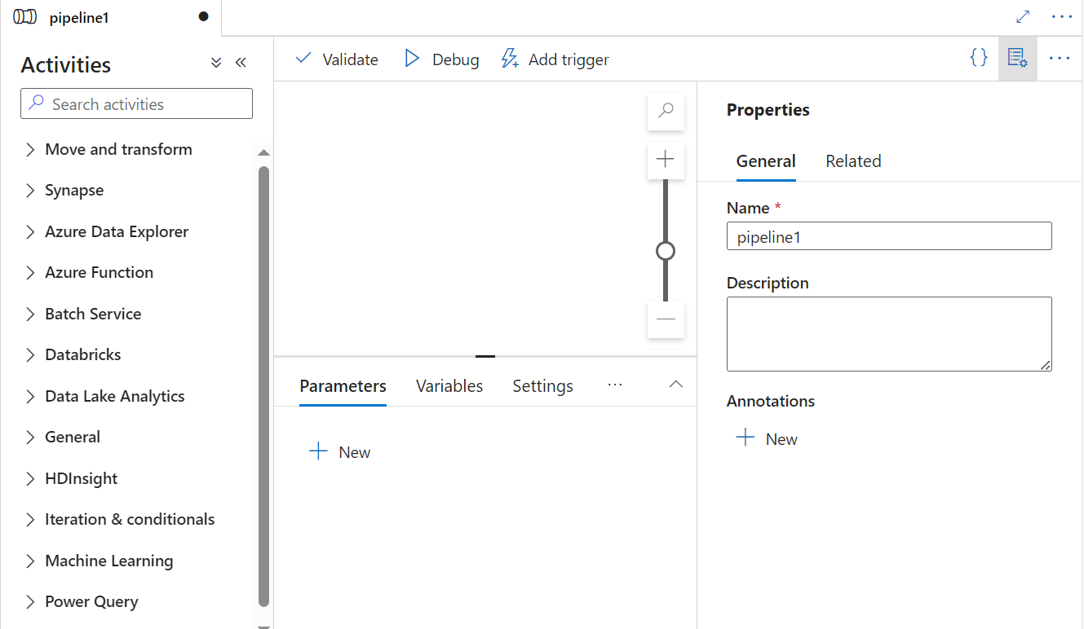
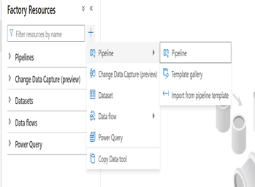
::Dive into Author Section::
This is the Heart of our ADF, where we can create Pipelines , Dataflows and their associated Datasets
So, let’s start with datasets and pipeline Click on + symbol and select dataset for the object’s
Here is the link to learn more about Datasets : https://learn.microsoft.com/en-us/azure/data-factory/concepts-datasets-linked-services?tabs=data-factory
For pipeline creations : click on + and select pipeline and give the meaningful name for that pipeline
Next

Slide 25
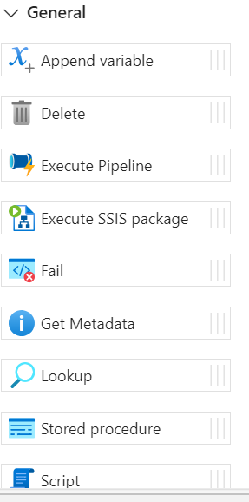
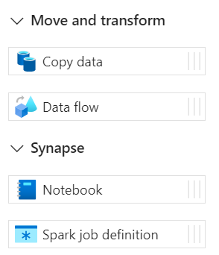
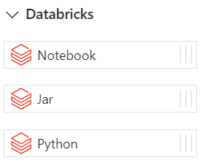
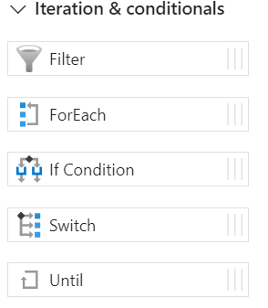
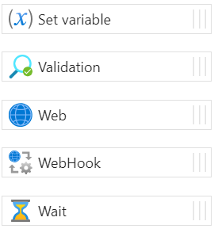
::Showcasing the Important Activities::
Overall, almost 39 different activities are presented under the activities section . But most important Activities sections are Move &Transform, General, Data Bricks, Iteration conditionals , Synapse

Slide 26
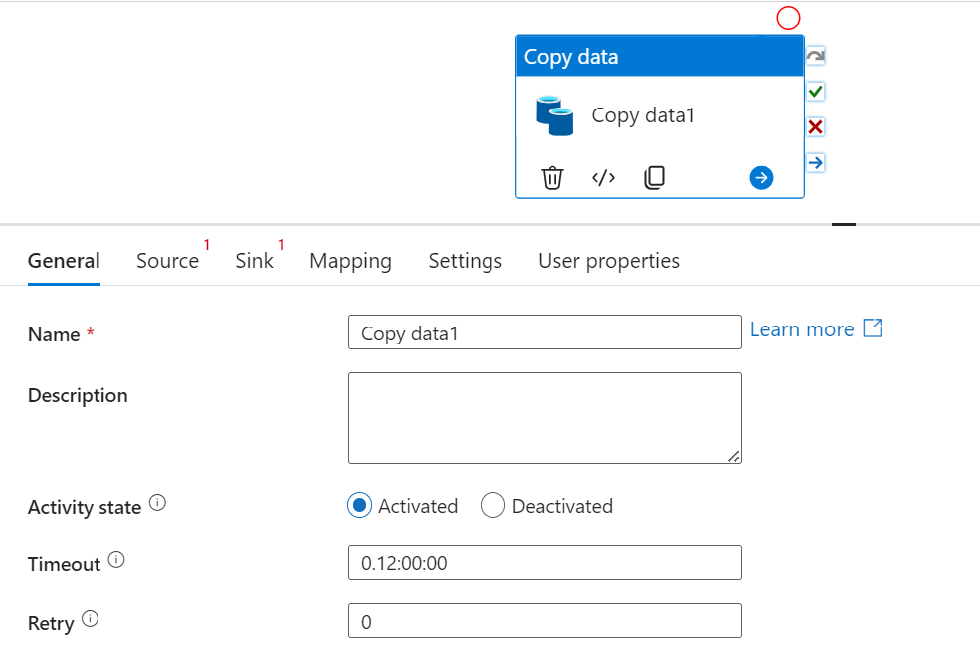
::Move and Transform ::
Copy Data Activity : This the Basic and Necessary activity presented in the ADF . The names itself suggest Copy. So , to move or copy the data that may be a File or table from One source to another source.
In general section provide meaningful name for that activity and description as well
Activity state means stating that activity is on or off
Timeout : Maximum amount of time an activity can run. Default is 12 hours, the minimum is 10 minutes, and the maximum amount of time allowed is 7 days. Format is in D.HH:MM:SS
Retry : max number of retry attempts . If pipeline fails
Source represents the source dataset and sink represents the Target location
More info : https://learn.microsoft.com/en-us/azure/data-factory/connector-sql-server?tabs=data-factory

Slide 27
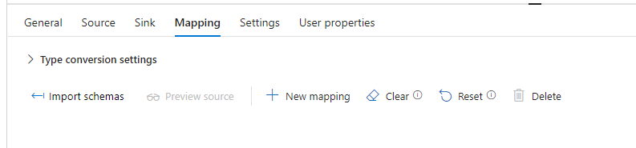
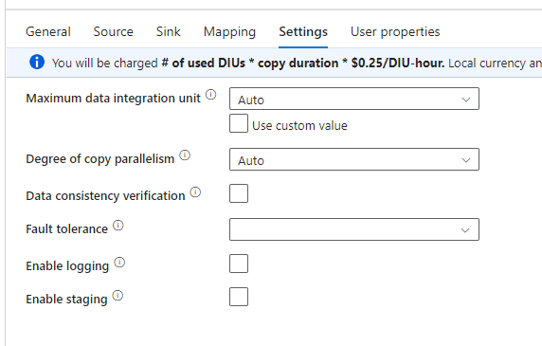
Copy Data Activity continue…
Mapping : It’s one of the Tab used to check and map the schema from source side and sink side
Settings : This Tab is majorly focused on the Optimization of Activity like increase the speed of data movement etc.,
CopyDataActivity Example : https://www.sqlshack.com/copy-data-between-azure-data-stores-using-azure-data-factory/

Slide 28
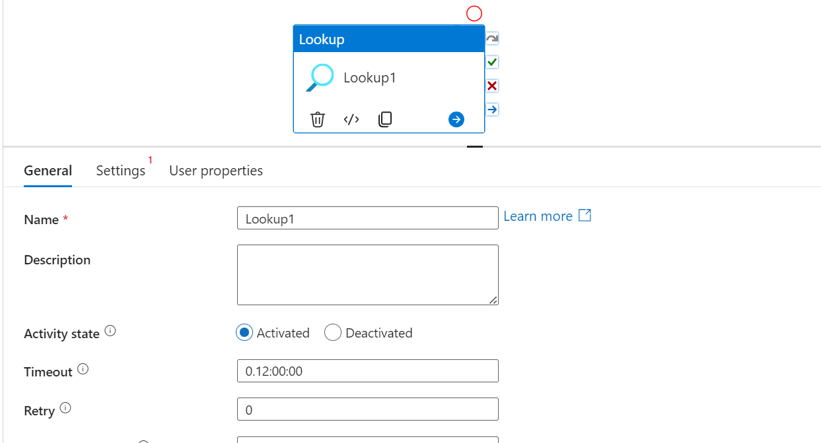
::General Activities::
Lookup : The name itself suggest that look for a data presented in the file or a table. Here is the link to get to know more about LookUp : https://learn.microsoft.com/en-us/azure/data-factory/control-flow-lookup-activity
Under settings Tab need to provide the required DataSet to retrieve the information or data

Slide 29
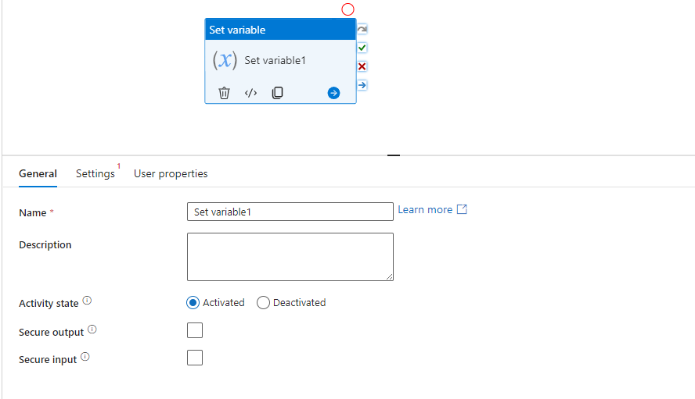
::General :: Set Variable Activity::
This activity is used to set or modified the variable pipeline variables .
Pipeline variables are nothing but values that can be set & modified during the pipeline run ex : we define a pipeline variable say with file path. So, that our copydataactvity use this path in the source
In settings Tab we need to define or use the variable which are defined previously . Majorly the set variable activity used when we want to compare the num of files written is equal to the variable value .
Useful Link : https://medium.com/codex/introduction-to-set-variable-activity-73bcddcf0318

Slide 30
::General :: Append Variable Activity::
Append Variable is used to update the variable value , that may be either comping from Set Variable activity or Normal Variable. Disclaimer: Append Variables Only Supports Adding To 'Array' Type Variables
It’s just used to add a value to an existing variable of type Array only
Example . Let’s define Two Pipeline variables or Variables say Marks and Output as type Array . Here we used Set Variable output is used to Show the Output from Append Variable
By using Append Variable will try to add new element into list say : 98. Now to show the Updated Marks variables we will use Set Variable.

Slide 31
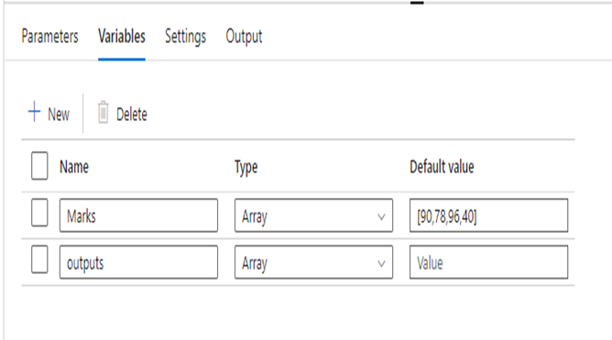
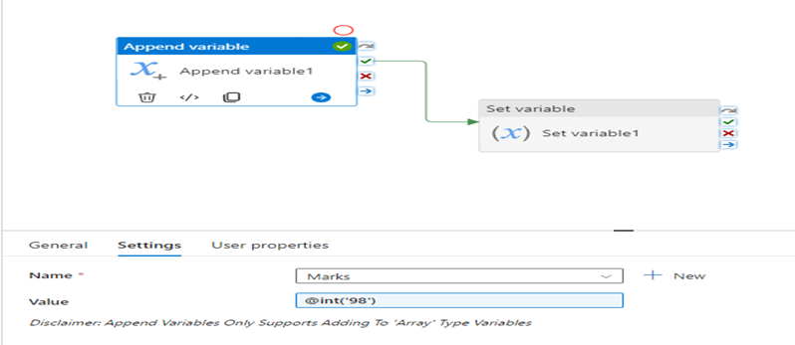
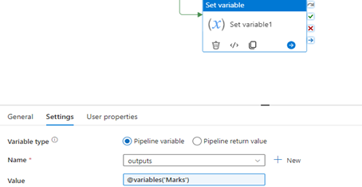
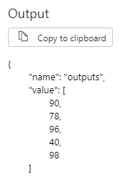
Example of Set and Append variable
1
2
o/p after appending

Slide 32
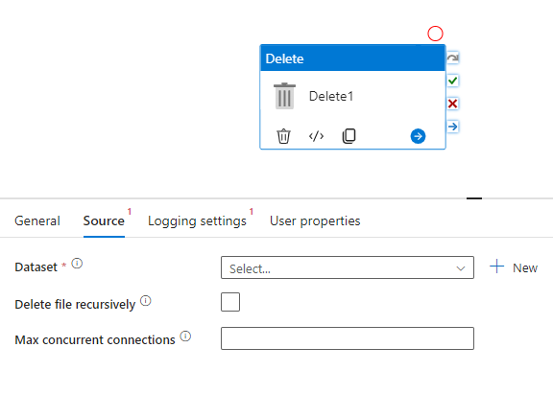
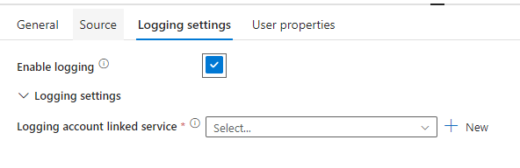
::General Delete Activity::
Delete Activity is used to Delete the file or folder present in the storage Accounts.
In source tab , pass the DataSet for which you want to delete it may be file or folder. Delete file recursively means that if is there any file underlined couple of folders and want to delete that one check that box. Max Concurrent connections are 10.
In Logging Settings Tab Enable Logging means : Specify whether you want to log the deleted file names in a logging store presented in the storage account (It’s an optional one, even you can uncheck the Box)

Slide 33
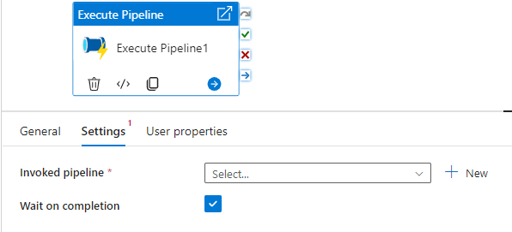
::General – Execute Pipeline Activity ::
Execute Pipeline is one the most widely using activity to Run or Trigger the Pipeline, because a Pipeline may have a combination activates like lookup, foreach, set variable, copy data etc . Instead of displaying that combination pipeline at time of running , we will associate or invoke that pipeline to this Execute Pipeline Activity
In settings Tab , Invoked Pipeline means give the Pipeline which you want to invoke into execute pipeline . Wait on Completion (check means ) it will wait until the any previous activity executes .

Slide 34
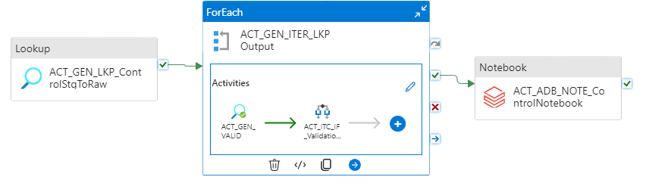
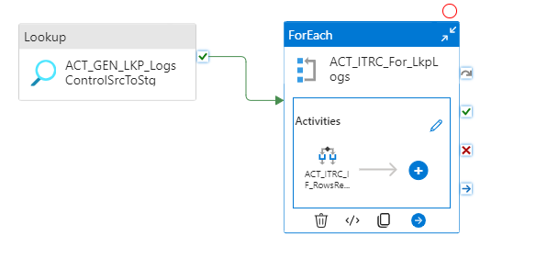
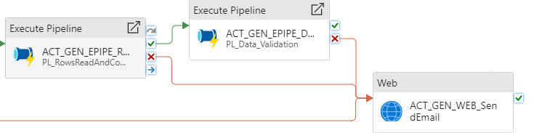
Example for Execute pipeline
Original pipeline : Here we have two sperate pipeline and they are combination of multiple activities .
Now, I want to run those two pipelines at a time under a single pipeline then I have to use Execute pipeline like this
1
2

Slide 35
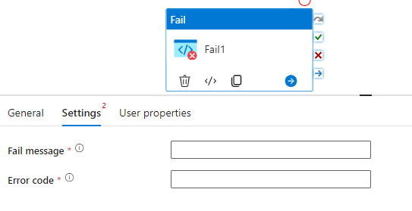
:: General – Fail Activity ::
Fail Activity is nothing but when you occasionally want to throw an error in a pipeline intentionally .
Fail Message means , message what you want to display as an output. Error code is like an error type say 404 etc.,
Example : You may expect some file to be available in blob storage location for further process. However, if the file wasn’t there due to some reasons, then your pipeline will fail abruptly (unexpectedly or in a rude way).By using Fail Activity here you can fail pipeline in a respectful manner by giving meaningful error code and message . In the next slide you can see the example of it
Useful link : https://azurelib.com/what-is-fail-activity-in-azure-data-factory-and-how-to-use-it/

Slide 36
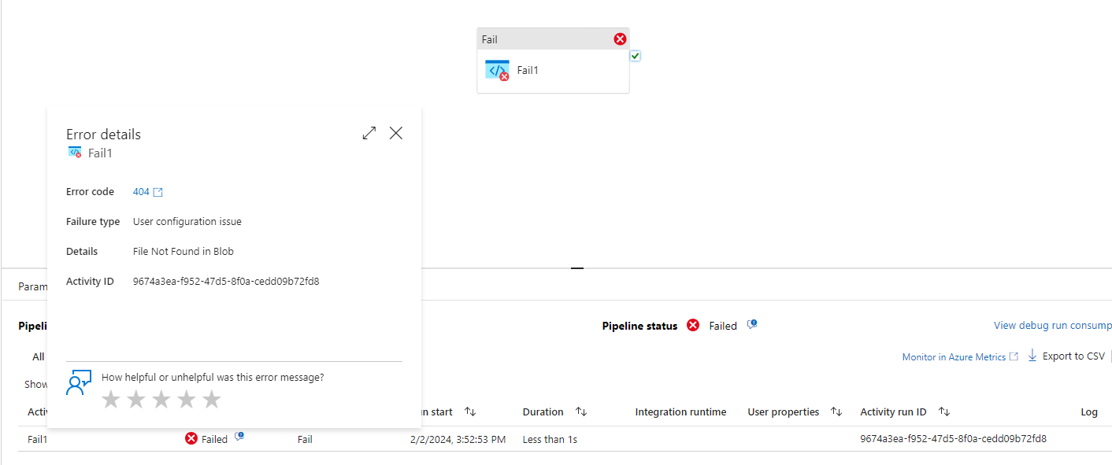
Fail Activity Example::

Slide 37
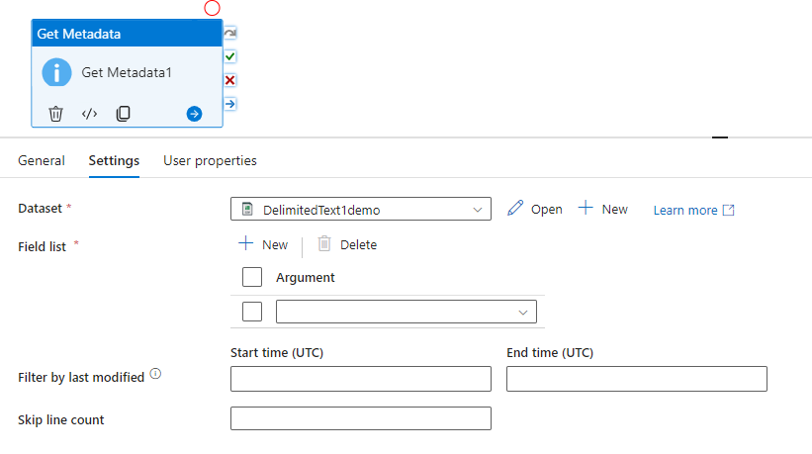
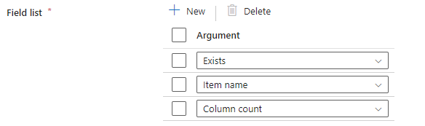
:: General – Get Metadata Activity ::
In the name itself saying that this activity is used to get relative metadata information that may be about a file, or a table like : column count, Exists, Item name, lastModifiedDate etc.,
In the settings Tab : Pass the Dataset object for which you want to get the metadata information .
Field list is the key here its dropdown has the number of metadata information like item name, column count etc.,
By clicking + symbol we can add a greater number of Field List
Useful Link : https://www.mssqltips.com/sqlservertip/6246/azure-data-factory-get-metadata-example/

Slide 38
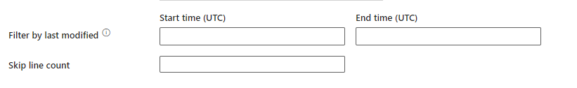
get metadata continue::
Filter By Last modified data represents :
The files with last modified time in the range [Start time, End time) will be filtered for further processing. The time will be applied to UTC time zone in the format of 'yyyy-mm-ddThh:mm:ss.fffZ'. These properties can be skipped which means no file attribute filter will be applied
Skip line count is used to skip the couple of rows from the top in a csv or excel file . For more info go through this link : https://nidhig631.medium.com/skip-line-count-in-adf-azure-data-factory-216f019cfa70
Use cases : You can use Get Metadata to get the latest file names and column count presented in the Storage account . Ex:https://www.linkedin.com/posts/lokeswar-reddy-valluru-b57b63188_bigdata-bigdataengineer-dataengineer-activity-7122035694419529728-7SHU?utm_source=share&utm_medium=member_android

Slide 39
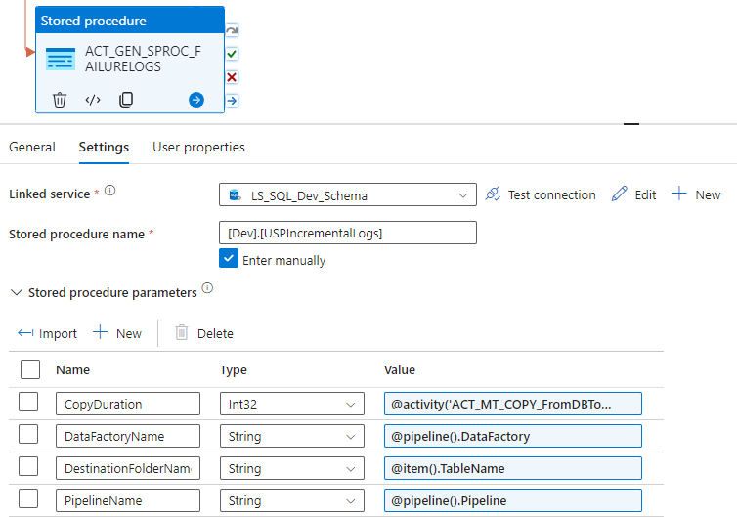
:: General – Stored Procedure Activity::
Stored Procedure Activity is used to execute the store procedure’s which you are defines or created in any database .
As you can see in the above picture that is the one of the example for the store proc activity in adf, which will use the store proc defines in sql database to achieve certain purpose . Once after giving the store proc name then click on import to import the parameters defined at time of store proc creation

Slide 40
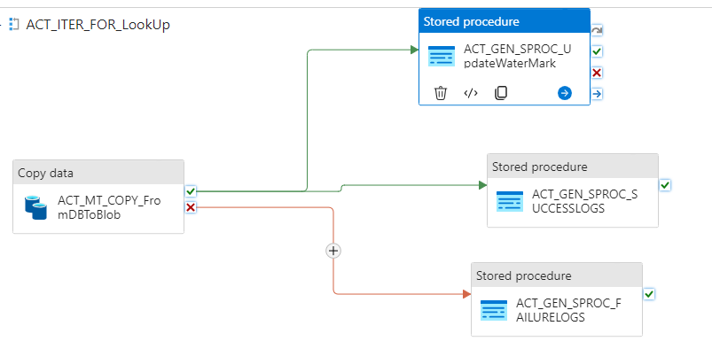
Store proc example::
In this example you can see we have 3 store proc utilization . I want to populate the logs table which is defined in sql database by taking the outputs from the copy data activity and also update the specific column value in the table from the copy data activity output value

Slide 41
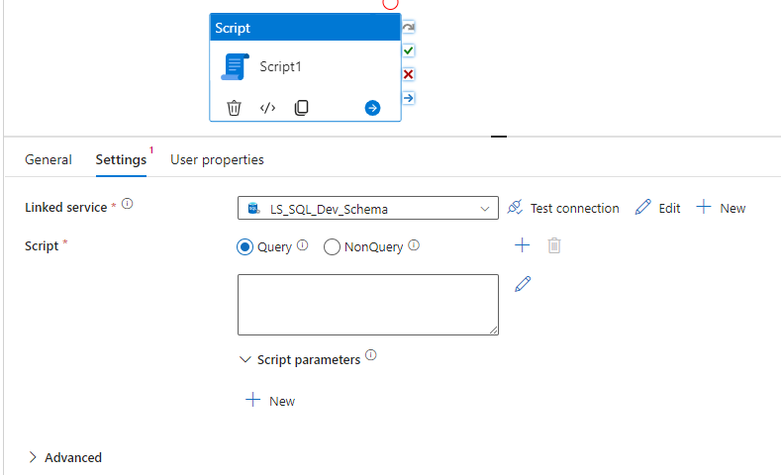
:: General –Script Activity ::
Using the script activity, you can execute common operations with Data Manipulation Language (DML), and Data Definition Language (DDL). DML statements like SELECT, UPDATE, and INSERT let users retrieve, store, modify, delete, insert and update data in the database. DDL statements like CREATE, ALTER, and DROP allow a database manager to create, modify, and remove database objects such as tables, indexes, and users.
As you can see in the above image after selecting the linked service for the Database then under the Script tab select Query and write our query like inserting the records, truncating etc., In No Query option is used to select when you want to create DB objects like Table etc., If our script requires any parameters, we can click on plus symbol under the script parameters. Advanced options tells you about logging enable and Execution time out
More info : https://www.sqlservercentral.com/articles/the-script-activity-in-azure-data-factory
https://techcommunity.microsoft.com/t5/azure-data-factory-blog/execute-sql-statements-using-the-new-script-activity-in-azure/ba-p/3239969

Slide 42
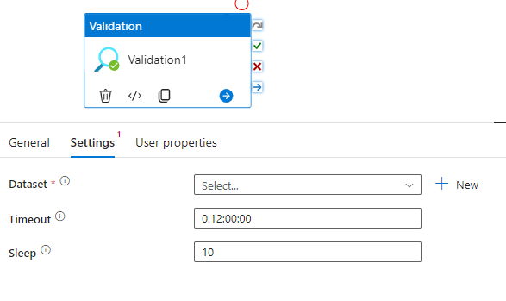
::General – Validate Activity::
It’s help us in validating something before executing out another activity mostly like Check for File in Storage Account, check for Table etc.,
Timeout says that: up to how many days I want wait for certain source or file to which we are validating. Sleep : says after every 10 sec re-execute .
For example, if you give the Dataset as one of the folder present in the container of any storage account then we will get Child Items as another option which is help for validation like False, True, ignore . Ignore means checks if folder exists only. False checks if a folder exists and it’s empty or not . True: check if a folder exists and has files in it.
Useful link : https://learn.microsoft.com/en-us/azure/data-factory/control-flow-validation-activity
https://www.sqlservercentral.com/blogs/validation-activity-in-azure-data-factory-traffic-light-of-your-operational-workflow

Slide 43
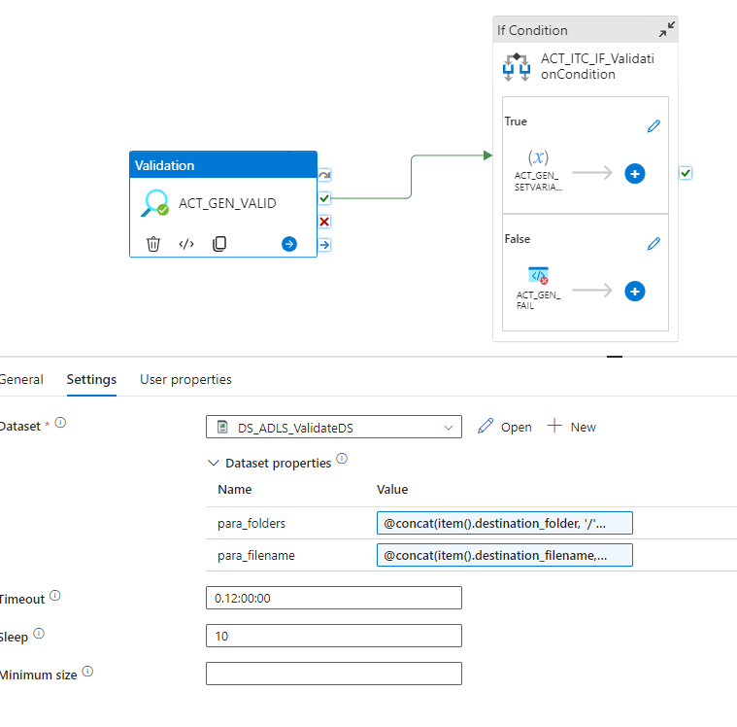
Example of validate activity::
Check or validate the files present in the folder which are passed with help of parameters. If activity output value is true the execute True condition in IF condition activity else execute False condition

Slide 44
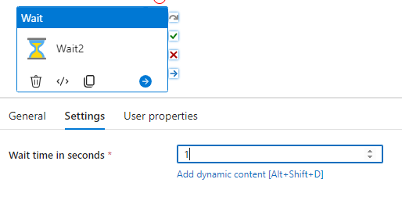
:: General – Wait Activity ::
When you use a Wait activity in a pipeline, the pipeline waits for the specified period of time before continuing with execution of subsequent activities.
Enter a number of seconds for the activity to wait. This can be a literal number, or any combination of dynamic expressions, functions, system variables, or outputs from other activities.
Useful link : https://learn.microsoft.com/en-us/azure/data-factory/control-flow-wait-activity

Slide 45
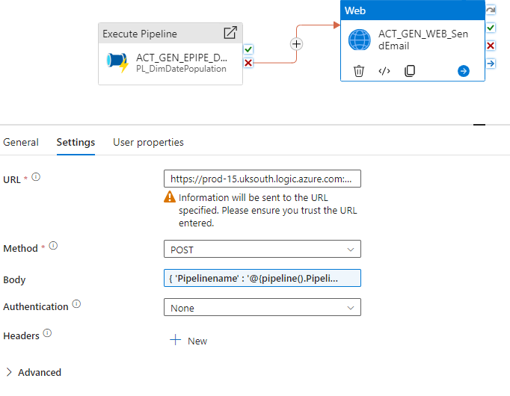
::General – Web Activity ::
Web Activity can be used to call a custom REST endpoint from an Azure Data Factory or Synapse pipeline. You can pass datasets and linked services to be consumed and accessed by the activity.
Web Activity can be easily integrated with other activities in a pipeline to create more complex data processing workflows
Useful link : https://learn.microsoft.com/en-us/azure/data-factory/control-flow-web-activity
https://faun.pub/introduction-to-web-activity-in-azure-data-factory-a8b5e7a971bd
For example : Here I am using a web-activity with HTTP trigger from logic-apps . When ever a pipeline fails, I want to send email to user or some one

Slide 46
::Iteration and conditionals::
The name itself says that use these activities present under the iteration and conditional when you want to loop through the data, filter, conditional etc.,

Slide 47
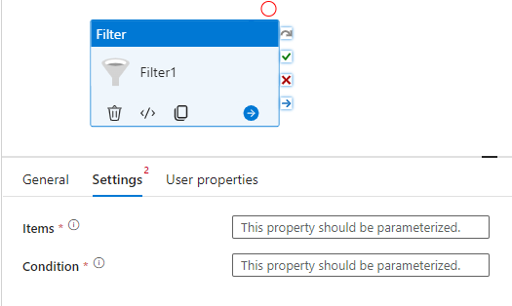
:: Iteration and conditionals- Filter Activity ::
Filter : The name itself say’s that , this activity is used to filter the output getting from another activity most of the times.
Items: Input array on which filter should be applied.
Condition : Condition to be used for filtering the input.
Ex: Let's define a Pipeline parameter with cities (array type) and filter out cities start with ‘H’ in the next slide
Useful links : https://learn.microsoft.com/en-us/azure/data-factory/control-flow-filter-activity

Slide 48
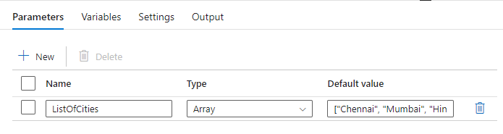
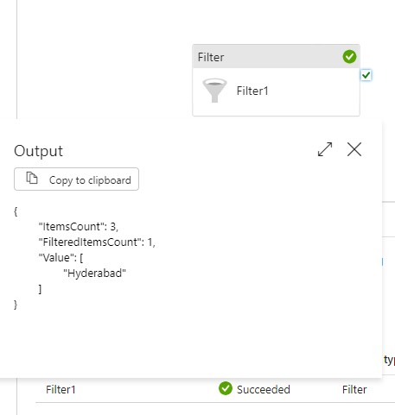

Filter Activity Example::
Parameter Name : cities of array type

Slide 49

:: Iteration and conditionals- For Each Activity ::
For Each activity is used to loop through the array of values .
In settings Tab : If u check the box of sequential then it iterates one by one through the input list .
Batch Count : Maximum number of parallel runs of inner activities
Ex : If you have the input list with 50 records , if you click on Sequential then it executes one-by-one . Instead, if u give the count say 20.. 20 records execute at single time . So, 50 : 20+20+10 like wise Batch count will work
Items : In this tab will the Input value
Activities Tab : we need to add one or more activities to be executed for each item in the input Items array
Useful link : https://learn.microsoft.com/en-us/azure/data-factory/control-flow-for-each-activity
https://nidhig631.medium.com/foreach-activity-in-azure-data-factory-adf-3aa76c4d57e0

Slide 50


Continue….
Note: inside the foreach activity we can’t add another foreach activity and until activity

Slide 51

:: Iteration and conditionals- If Condition Activity ::
If condition activity is same as if , else statement . It will evaluate the expression , if it’s true then Activities In True case will execute , else False case will execute
Expression : Expression of If Condition activity, the value must evaluate to true or false
For example : Let’s define two parameters
ListofCities of array type and CitySearch of
String type . If Value of CitySearch is in ListOfCities
Then execute True, else False
Useful links : https://learn.microsoft.com/en-us/azure/data-factory/control-flow-if-condition-activity

Slide 52



Example for If-condition ::
Pass the value for CitySearch parameter at run time

Slide 53

:: Iteration and conditionals- Switch Condition Activity ::
The Switch activity provides the same functionality that a switch statement provides in programming languages. It evaluates a set of activities corresponding to a case that matches the condition evaluation.
In Activities Tab : Need to a Enter an expression for the Switch to evaluate. This can be any combination of dynamic expressions, functions, system variables, or outputs from other activities.
Select Add case to add additional cases. If no case matches, the Default case activity will be used.
Useful link : https://learn.microsoft.com/en-us/azure/data-factory/control-flow-switch-activity
https://datanrg.blogspot.com/2019/10/switch-activity-in-azure-data-factory.html

Slide 54


Switch activity Example::
Let's define a pipeline parameter called environment_name with string type. So , if I pass environment_name as dev then dev case should execute else default and define two variables case_1op, case_2op

Slide 55

:: Iteration and conditionals- Until Activity ::
It executes a set of activities in a loop until the condition associated with activity evaluates to True. Once condition is true it stops the execution, whereas For Each executes until the condition is false. Stop when you reach the Destination is nothing but a Until Activity (means condition True)
Expression of Until activity, the value must evaluate to true or false
Under the Activities Tab, we need to add activity to me further process once the condition is true.
Useful link : https://learn.microsoft.com/en-us/azure/data-factory/control-flow-until-activity
https://www.mssqltips.com/sqlservertip/6206/azure-data-factory-until-activity-example/

Slide 56
Wait vs Until
The Until activity is a compound activity. It executes its child activities in a loop, until one of the below conditions is met:
The condition it's associated with, evaluates to true
Its timeout period elapses
The Wait activity causes pipeline execution to pause for a specified period, before continuing with the execution of subsequent activities. This activity has a single parameter, waitTimeInSeconds, which identifies a wait period in seconds. We will be using this activity as part of the sample solution to demonstrate iteration logic in the next sections.
Until use case: You have a pipeline that copies data from an on-premises SQL Server into Azure Data Lake Storage. The pipeline will be triggered on a schedule at midnight every day. However, third party upstream systems mean the SQL tables may not actually be ready at midnight and we need to wait “until” they are. The SQL database tables are loaded locally using SQL Agent jobs; therefore, we want to check when a particular agent job has completed before the upload into Azure

Slide 57


Until example::
Sample example with timeout error: give time out as 10 sec, with in the 10sec if we won’t get the value then pipeline will fail. According to our example , if varx doesn’t reaches the 30 with in 10sec timeout then our pipeline is going to be fail.

Slide 58


Continue…
As, you can see in the output pipeline failed due to timeout error and varx value updated up to 8

Slide 59
::Data Bricks Activities::
Data Bricks Activities are nothing but , it’s used to execute activities like data bricks notebook, JAR and python which are useful when we written our custom code using python or java or scala for data processing and need to execute in ADF.

Slide 60


Continue….
In general, Data Bricks is one of resource or IDE in Azure used to write the custom code for the data processing and transformation . Files in Data Bricks is called as “Notebook”.
In Azure DataBricks tab provide the DataBricks Linked service
In settings Tab : Mention the Notebook path to be executed
Base parameters : if there are any parameters mentioned for our notebook then pass those parameters here.
Useful link : https://learn.microsoft.com/en-us/azure/data-factory/transform-data-using-databricks-notebook

Slide 61


:: DataBricks – Jar Activity ::
Jar activity is used to execute the java or scala code written in the DataBricks
In settings Tab :
Main Class Name : The full name of the class containing the main method to be executed. This class must be contained in the JAR provided under append libraries. Parameters are nothing but Parameters that will be passed to the main method.
Useful link : https://learn.microsoft.com/en-us/azure/data-factory/transform-data-databricks-jar

Slide 62

:: DataBricks – Python Activity ::
Python Activity : If you use a plain python file, you will need to instantiate your own SparkSession so the code will run locally
In settings Tab:
Python file : The URI of the Python file to be executed. DBFS paths are supported. To get this DBFS URI, use the Databricks CLI, click to view more information.
Useful link: https://learn.microsoft.com/en-us/azure/data-factory/transform-data-databricks-python

Slide 63

::Azure Function::
Azure function : it’s a serverless function used to execute the custom code written by the following programming languages like .NET, Python, c# etc.,
The Azure Function activity allows you to run Azure Functions in an Azure Data Factory or Synapse pipeline. To run an Azure Function, you must create a linked service connection. Then you can use the linked service with an activity that specifies the Azure Function that you plan to execute.
Provide the Azure function linked service
Mention the Function name you defined
Method : REST API method for the function call
Headers that are sent to the request. For example, to set the language and type on a request: "headers": { "Accept-Language": "en-us", "Content-Type": "application/json" }
Useful link : https://learn.microsoft.com/en-us/azure/data-factory/control-flow-azure-function-activity

Slide 64
:: Triggers in Azure ::
Triggers are used to orchestrate or execute the Pipelines at specified time interval . Under the Manage component, we have author section where you can create the Triggers.
Basically, triggers are of 3 types, and they are Schedule Trigger, Event Based Trigger, Tumbling window trigger.
Note : One pipeline can have multiple triggers, But one Trigger can’t associate with multiple pipeline
1 pipeline : N Triggers
1 Trigger : 1 pipeline
Schedule Trigger: One of the most used trigger to execute of our pipeline at specified time interval.
Event Based Trigger : This trigger execute the pipeline , based on any event happened
Tumbling Window Trigger : This will execute our pipeline on window basis

Slide 65

::Scheduled Trigger::
As, we discussed earlier Schedule trigger is used to execute our pipeline at scheduled time.
For example, You want to run your pipeline on daily basis to bring the data from Source To Target at some specified time like 02:30 AM
Useful link:
https://learn.microsoft.com/en-us/azure/data-factory
/how-to-create-schedule-trigger?tabs=data-factory

Slide 66
Schedule trigger continue::::
Start Date : Represents , on which date onwards your pipeline must start or invoke
Time Zone : Mention the Time Zone at which your pipeline must start
Recurrence : Means repetition like for every 15min my pipeline must run or for every 24hrs my pipeline must run .
Specify an End date is an optional one, it says that if you specify the end date then your pipeline schedule trigger execution will stop once it reaches the end date
Once after specifying all the details check the box start trigger on creation so, that it start the trigger when you publish it.
Next step, assign the trigger to the pipeline which you want to run as schedule one

Slide 67
::Tumbling window Trigger::
Tumbling window trigger will work on window-based functionality means.. If you designed a pipeline which will copy the data from source to target. Instead of copying data as a batch , tumbling window trigger will copy as window (some part of data once and another part of data in another window)
Especially used when you want to copy historical data. Using Tumbling window trigger you can specify the past dates as well.
Example : You have orders data Table from 2019-12-01 to 2022-12-01, so using Tumbling window trigger instead of copying whole data as batch , we will create window like for every 24hr or every 1month . So, it’ll copy the data from 2019-12-01 to 2020-01-01 as One window . Whereas in Schedule Trigger you don’t have these kind of advantages , in schedule trigger you can not go past dates.
Always use Schedule Trigger for Future or present runs , while Tumbling window trigger for past as well as future runs
Useful links : https://www.mssqltips.com/sqlservertip/6061/create-tumbling-window-trigger-in-azure-data-factory-adf/
https://learn.microsoft.com/en-us/azure/data-factory/tumbling-window-trigger-dependency

Slide 68

Tumbling window trigger continue::::
Start date and end date has same meaning defined as for the Schedule trigger
Recurrence it’s key here to create the window
In Advanced section you can add dependencies means: In scenarios where the trigger shouldn't proceed to the next window until the preceding window is successfully completed
Delay : The delay before data processing of the window starts
Maximum concurrency : The number of simultaneous trigger runs that are fired
Retry policy count : The number of retries before a pipeline run is marked as "Failed“
Retry policy interval : The number of seconds between each retry attempt
Once defining all the required details click on start trigger on creation and assign to the pipeline for which you want to run as Tumbling window trigger

Slide 69
::Event Based Trigger::
Event Based Trigger or storage event trigger, will invoke or trigger the pipeline when ever some events happened in the specified storage account like file created or deleted (events)
Useful link : https://learn.microsoft.com/en-us/azure/data-factory/how-to-create-event-trigger?tabs=data-factory
https://www.mssqltips.com/sqlservertip/6063/create-event-based-trigger-in-azure-data-factory/
Note : Event Based trigger will only works on event happens on top of storage account only
For example : When ever a file landed in the raw container in one of the storage account then our pipeline has to trigger and copy that file from raw to bronze like that..

Slide 70
Continue….
Select Storage events from Type drop down.
Mention the subscription details , storage account name and container name
Blob path begins with : Blob means file here For example: '2018/April/shoes.csv' or '2018/’
Blob path ends with : ‘Blob path’ must end in a file name or extension. For example, 'shoes.csv' or '.csv'. Container and folder name are optional but when specified they must be separated by a '/blobs/' segment. For example, '/orders/blobs/2018/april/shoes.csv'. To specify a folder in any container, omit the leading '/' character. For example, 'april/shoes.csv’.
Event : Choose which events are associated with this trigger like Blob created or Blob Deleted
Ignore empty blobs : If selected, blobs with zero bytes will be ignored and will not generate a pipeline run
Then in the end click on start trigger on creation and then click on continue and publish
Useful link: https://youtu.be/h4oWyblgNPM?si=XACE8W8bW42VkRsJ

Slide 71

:: Data Flows ::
Data Flows are no-code activities used to process the data . To implement or run Data Flows we will use Data Flow activity under the Move and Transform
Open ADF and click on author section to create the Data Flows . Data Flows run behind on cluster like an engine for car or bus
Useful link : https://learn.microsoft.com/en-us/azure/data-factory/concepts-data-flow-overview
https://learn.microsoft.com/en-us/azure/data-factory/control-flow-execute-data-flow-activity

Slide 72

Continue…
To run the data flows which we created to do data processing then open pipeline section and go to Move &Transform then select Dataflow.
In settings Tab : select the data flow transformation pipeline to which you want to run . Select compute size like small, large , medium (compute means cluster)
In advance tab you can select core count and compute type as well
Logging level: Toggle the amount of monitoring output by the data flow activity. Verbose is the default setting that shows the partitioning information and rows output for every transformation. Basic doesn't return partitioning information. None only returns the source rows read and sink rows loaded. Less monitoring output can lead to improved performance
Staging :
Staging should only be configured
when your data flow has Azure Synapse Analytics
as a sink or source.

Slide 73


Continue…
In parameters Tab : If you passed any parameters for Data flow transformations that should be mentioned here as well
Data Flow Activity is same as Execute Pipeline activity , which execute different data flows transformations

Slide 74
Important points in Data Flows
Allow Schema drift : if the source columns will change often. This setting will allow all incoming fields from your source to flow through the transformations to the Sink.
Infer drifted column types : Allow auto-detection of drifted column types
Validate schema : this option will cause data flow to fail if any column and type defined in the projection does not match the discovered schema of the source data. Opposite to Allow schema drift

Slide 75

::Different Data Flows Transformations::
Go to the Data Flows section under the Author, click on create new data flow . Then it’s open up a new workspace where we can add data flow transformations like filter, lookup, select etc.,
For any kind of data flow transformations pipeline source and sink are must
Select Add source

Slide 76

::Data Flow Transformation – source::
Source transformation is same as source in Copy Data activity where will provide source details that may be a file or table
In source settings tab :
Output stream Name : means display name at outputs like
Table Source
Source Type : Dataset means whatever the datasets we created
earlier , inline means new datasets but can’t be used for another
Transformations (only applicable for this transformation only)
Options : Always check the box for allow schema drift
And infer drifted column types. You can’t click on validate schema
Until you un-check the allow schema drift
Sampling : Use Sampling to limit the number of rows from your Source.
This is useful when you need just a sample of your source data
for testing and debugging purposes.
Useful link :
https://learn.microsoft.com/en-us/azure/data-factory/data-flow-source

Slide 77
Source transformation continue…
Source Options : The Source options tab contains settings specific to the connector and format chosen
Like wildcard paths, multiline rows etc.,
Projection: The projection in a source defines the data columns, types, and formats from the source data. For most dataset types, such as SQL and Parquet, the projection in a source is fixed to reflect the schema defined in a dataset. When your source files aren't strongly typed (for example, flat .csv files rather than Parquet files), you can define the data types for each field in the source transformation.
Optimize : The Optimize tab contains settings to configure partitioning schemes.
Inspect : The Inspect tab provides a view into the metadata of the data stream that you're transforming. You can see column counts, the columns changed, the columns added, data types, the column order, and column references. Inspect is a read-only view of your metadata.
Data preview : If debug mode is on, the Data Preview tab gives you an interactive snapshot of the data at each transform
We can add N number of Sources if want

Slide 78

:: Data Flows –Sink Transformation ::
Sink Transformation is used as destination activity same as sink in copy data activity. Sink always expects the incoming stream means output from any another transformation like source , select etc.,
Output stream name has the same meaning as like source transformation
Incoming stream : Means from which transformation you are expecting the output data . Here it’s Source Transformation
Sink Type : we have dataset, inline , cache. Dataset, inline have the same meaning as what we defined in source side. But here cache is the new kind of thing.
Cache : In stead of writing output to any
Data store , will keep in cache and then we will
do lookup kind of activity on top of data in Cache

Slide 79

:: Data Flow – Conditional Split Transformation ::
Conditional split transformation routes data rows to different streams based on matching conditions. Like case when ,switch separating department_id = 10 data into one separate file and department_id = 20 into another separate file
Useful link : https://learn.microsoft.com/en-us/azure/data-factory/data-flow-conditional-split
Select the incoming stream ..
Split on: tick on first matching condition

Slide 80


Continue..
Split on : First matching condition it’s default one
Split condition : you can add N number of conditions by clicking plus symbol

Slide 81

:: Data Flow – Exists Transformation ::
Exists transformation is a row filtering transformation that checks whether your data exists or doesn’t exists in another source or stream
Useful link : https://learn.microsoft.com/en-us/azure/data-factory/data-flow-exists
Here right stream is source2 and left stream is source1

Slide 82

::Continue… exists transformation::
Exists : Get the data of left stream which exists in right stream.(s1 exists in s2)
Doesn’t exists get the data of left stream which doesn’t exists in right stream (s1 doesn’t exists in s2)
Exists same as inner join . Doesn’t exists same as left anti-join (return rows from left table that doesn’t have matching keys in the right table)

Slide 83

:: Data Flows union Transformation ::
Union Transformation will combine multiple data streams into one with out need of join key
Useful link : https://learn.microsoft.com/en-us/azure/data-factory/data-flow-union

Slide 84

Continue…
Union by : Name means . If two data streams or sets have same column name, then it’ll do union. If names mismatched , no union would occur
Union by position : Suppose 1st data source have 8 columns and 2nd data source have 3 columns then go with by position

Slide 85

:: Data Flow Join Transformation ::
Join Transformation is used to combine or merge multiple data sources on join key same as in SQL, PYSPARK , PANDAS
Useful link : https://learn.microsoft.com/en-us/azure/data-factory/data-flow-join

Slide 86


::Data Flow - Aggregate Transform ::
Aggregate Transformation is like group by in SQL or spark or pandas . It defines aggregations of column in our data stream. Group by on one important column and do the aggregations like sum, min, max, count
Output stream and input stream has the same meaning what we defined earlier
Useful link: https://learn.microsoft.com/en-us/azure/data-factory/data-flow-aggregate
https://medium.com/@davidmcc9568/etl-with-azure-data-factory-data-aggregation-and-transformation-44420677bb

Slide 87

Aggregate Example::
Typical Example looks like:

Slide 88

::Data Flow – Surrogate Key ::
It’s used to add an Incrementing key value to each row of data . It’s useful when we are inserting data into Dimension table, for Dimensions table we required a unique key i.e., Non-business Key
Key Column means: Name of the column you want to add
Like Emp_Skey, Customer_Skey
Start value mean : what would be your starting value like 1 or
100 or 1000
Step value means : Increment value . If I specify 1 means
1-2-3-4….n. If I specify 2 means 1-3-5-7…n
Useful link : https://learn.microsoft.com/en-us/azure/data-factory/data-flow-surrogate-key

Slide 89

:: Data Flow – Look Up Transformation::
Look up transformation is different from Lookup activity in Pipeline activities . This Look Up transformation is like left join , returns all the records from the left table and matched from right table
Primary stream is like Left Table and Lookup stream is right table
When you check the Match Multiple rows Box, then it
Return all matched rows from lookup stream
Match on : 1.Any Row , we will get either first or last rows of
matching records
2.First Row, returns first row of matching records after sorting
3.Last Row, return Last row of matching records after sorting
Finally, lookup condition like deptno == deptno
Lookup useful while loading data into Dim and facts . One need
To validate if data already exists, then take the corresponding
Action like insert or update the data
Useful link : https://learn.microsoft.com/en-us/azure/data-factory/data-flow-lookup

Slide 90

::Data Flow – Filter Activity::
Filter Transformation is used to filter out the data from incoming stream based on the expression like filter out deptid = 20 , deptid isNull etc, deptno==20&&sal>1500
Useful link : https://learn.microsoft.com/en-us/azure/data-factory/data-flow-filter

Slide 91


Lookup & Filter Example::
Employees
Departments

Slide 92



Lookup & Filter Example::
Let’s try to get the employees who’s doesn’t have dept and using filter activity to filter for emp’s

Slide 93

Continue..
Here the output after filter activity looks like … the records of employees who doesn’t have the deptno

Slide 94

::Data Flows – Select Transformation ::
Select Transformation is used to select required column only from incoming data stream , just like a select query in sql
If you see the example of Lookup and filter in earlier slides , we can add select transformation at end and select only columns from Employees
Useful link : https://learn.microsoft.com/en-us/azure/data-factory/data-flow-select

Slide 95


::Data Flow – Derived Column ::
It’s used in a case when there is a need to create new calculated fields or update data in the existing fields in a data stream like adding age column from DOB column , adding Eff_EndDate and Eff_StartDate column, capitalizing the names
In the Example one , we will take input stream from employees and try to convert first_name to Upper case ,adding full_name column to the existing source or stream
Useful link : https://learn.microsoft.com/en-us/azure/data-factory/data-flow-derived-column

Slide 96


Derived-column ex2:
In ex2, if deptno is 10 then add column called derived with Not Bad like wise
Expression: case(Dept_no==10, 'Not Bad', case(Dept_no==20, 'Good', 'Well'))

Slide 97

::Data Flow – Pivot Transformation::
Converting Unique values of rows from a field or data as column is known as “Pivoting Data”. Use the pivot transformation to create multiple columns from the Unique row values of a single column
It’s also a kind of aggregation transformation where you will select group by column and generate pivot data
Useful link : https://learn.microsoft.com/en-us/azure/data-factory/data-flow-pivot
https://sqlskull.com/2020/10/07/azure-data-factory-pivot-transformation-using-data-flow/

Slide 98
Pivot continue::
1.Group By tells you that provide the name of columns to Group By, based on these columns data is aggregated for the columns that you will provide in pivoted columns, and the output data will group all rows with the same group by values into one row.
2.Pivot Key : here you will provide the column whose row values get pivoted into new columns
like year, Gender, country etc.,
3.Pivoted columns: For each unique pivot key value which are converted to columns, generates an aggregated row value for each group.
You can also create multiple columns per pivot key and each pivot column must contain at least one aggregate function.
Column name pattern It allows you to format the column name of each pivot column so the outputted column name will be a combination of the pivot key value, column prefix and optional prefix, suffice, middle characters.
Column arrangement It allows you to choose how you want the columns to be ordered, If you generate more than one pivot column per pivot key,
Column prefix This is an optional if you only have one pivoted column. In case, If you generate more than one pivot column per pivot key, you need to enter a column prefix for each column.

Slide 99


Pivot example:
In this example we will get the report total quantity of item sold per year
Here additionally I used derived columns for converting string to date and taking year from converted column

Slide 100


Pivot example continue::
Exp for derived column convert string to date . While converting string to date sometimes we will get Null’s as a result . So, use iiNull() exp as sale_date_M column
For year, use another derived column and exp is : year(sale_date_M)
iifNull(toDate(sale_date, 'yyyy/MM/dd'), toDate(sale_date, 'yyyy-MM-dd'))

Slide 101


Continue..
In pivot transformation use Item column as group By column to get the unique rows out of it
In pivot Key use Year as key where rows converted into columns
In pivoted columns, write exp to calculate Total Quantity

Slide 102


::Data Flow – unpivot ::
Pivot is from multiple rows into columns. Unpivot is from multiple columns into a single column
Useful link : https://learn.microsoft.com/en-us/azure/data-factory/data-flow-unpivot
ungroupBy : which column do you want to ungroup
Unpivot key : The Unpivot Key is the column that the service will pivot from column to row
Unpivoted columns: choose the column name for storing the values for unpivoted columns that are transformed into rows.
(Optional) You can drop rows with Null values.
For instance, count_emp is the column name that is chosen in the below example

Slide 103



Unpivot example:
Group by DeptNo , then remaining columns becomes values

Slide 104

::Data Flows – Rank Transformation::
Use Rank Transformation to generate an ordered ranking Based upon sort condition specified by the user. Its same as Rank in sql, pyspark
Useful link : https://learn.microsoft.com/en-us/azure/data-factory/data-flow-rank
Rank Column : specify the name of
the rank column like rn, rn_col
Sort Conditions: Specify on top of which column you
Want to provide rank in an order
If you select Dense : you will get consecutive rank
Values without skipping

Slide 105

::Data Flows – Window Function ::
This is same as Window Function in sql, pyspark , where we define window-Based aggregation of columns in our data streams.
Over : on which particular column you want window like id, department etc.,
Sort : Sort the columns either by asc or desc
Range by : select unbounded in most of the cases
Window Columns : it’s ask to mention the column name for final output like avg_sal etc.,
Useful link : https://learn.microsoft.com/en-us/azure/data-factory/data-flow-window

Slide 106


::Data Flows – Flatten Transformation ::
This transformation is used to convert values in an array or any nested structure to flattened rows and column structure . Or Use this to take array values inside hierarchical structures such as json and unroll them into individual object
In source : settings Tab select JSON , then Choose whether your files contain single JSON, multiple JSON in separate lines, or in array format.
Array of documents means Json inside the array format
In flatten :
Unroll by : Choose the array in your data to flatten
Useful link : https://learn.microsoft.com/en-us/azure/data-factory/data-flow-flatten
Example:

Slide 107

Flatten example continue::
At source select JSON in settings as Array of documents, because our Json data is enclosed between array
Select Unroll by as column which consist of array or list.

Slide 108

::Data Flow – Alter Row::
Use the Alter Row transformation to set insert, delete, update, and upsert policies on rows.
Useful link : https://learn.microsoft.com/en-us/azure/data-factory/data-flow-alter-row
Especially used when we need to insert data into Table or Dimension models by like SCD2, SCD1
Example: https://www.linkedin.com/pulse/alter-row-transformation-mapping-data-flow-narmadha-nithyanandam/

